Slide 1



Development of an intelligent technique for road incident detection
Group No: 8
Group Members:
A-802 Ahire Nameet
A-829 Gawade Sakshi
A-833 Gole Nishita
Guided By:
Prof. B. M. Patil

Slide 2
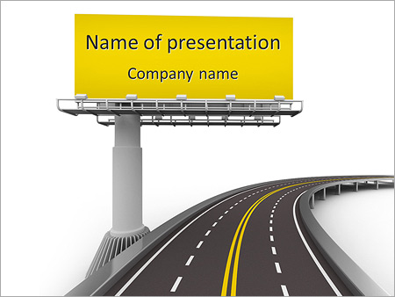
Table of Contents:
Abstract
Introduction
Aims and Objectives
Literature Survey
Existing System
Drawback of the existing system
Problem Statement
Proposed System
Methodology
Algorithms
Hardware and Software requirements
Implementation plan
Conclusion
References

Slide 3
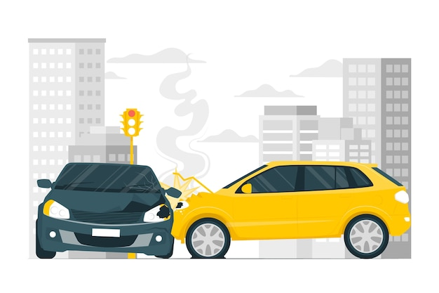
Abstract
The leading cause of death in India is accidents. More than 80% of the victims are not caused by the incidents occurring, but by the failure to provide timely assistance to the victims.
On highways where there is really light traffic and a quick accident victim could be left unattended for a long timetime.
The aim is to create a system that can record events on video from CCTV cameras installed on highways. The goal is to capture every frame of the video and run it through a deep learning convolutional neural network trained to classify video footage as accidental or non-accidental.
Convolutional neural networks offer fast, accurate image classification with over 95% accuracy for smaller datasets and minimal preprocessing.

Slide 4
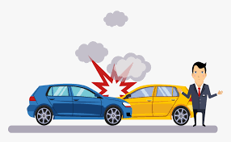
Introduction
Road safety and efficiency are crucial in technology advancements, preventing accidents and threats.
To address these challenges, Innovative solutions for road incident detection require artificial intelligence and computer vision, including a web-based application in Python using CCTV, Darknet YOLO and OpenCV.
By combining these concepts with Python, a powerful and efficient system can identify and classify events such as crashes and shutdowns.
This web-based application demonstrates the potential of artificial intelligence and computer vision and offers practical solutions to improve safety and traffic management.
Users can access the system via a web interface that provides real-time status monitoring, automated alerts and decision-making information for traffic authorities, traffic emergency services and passengers.

Slide 5
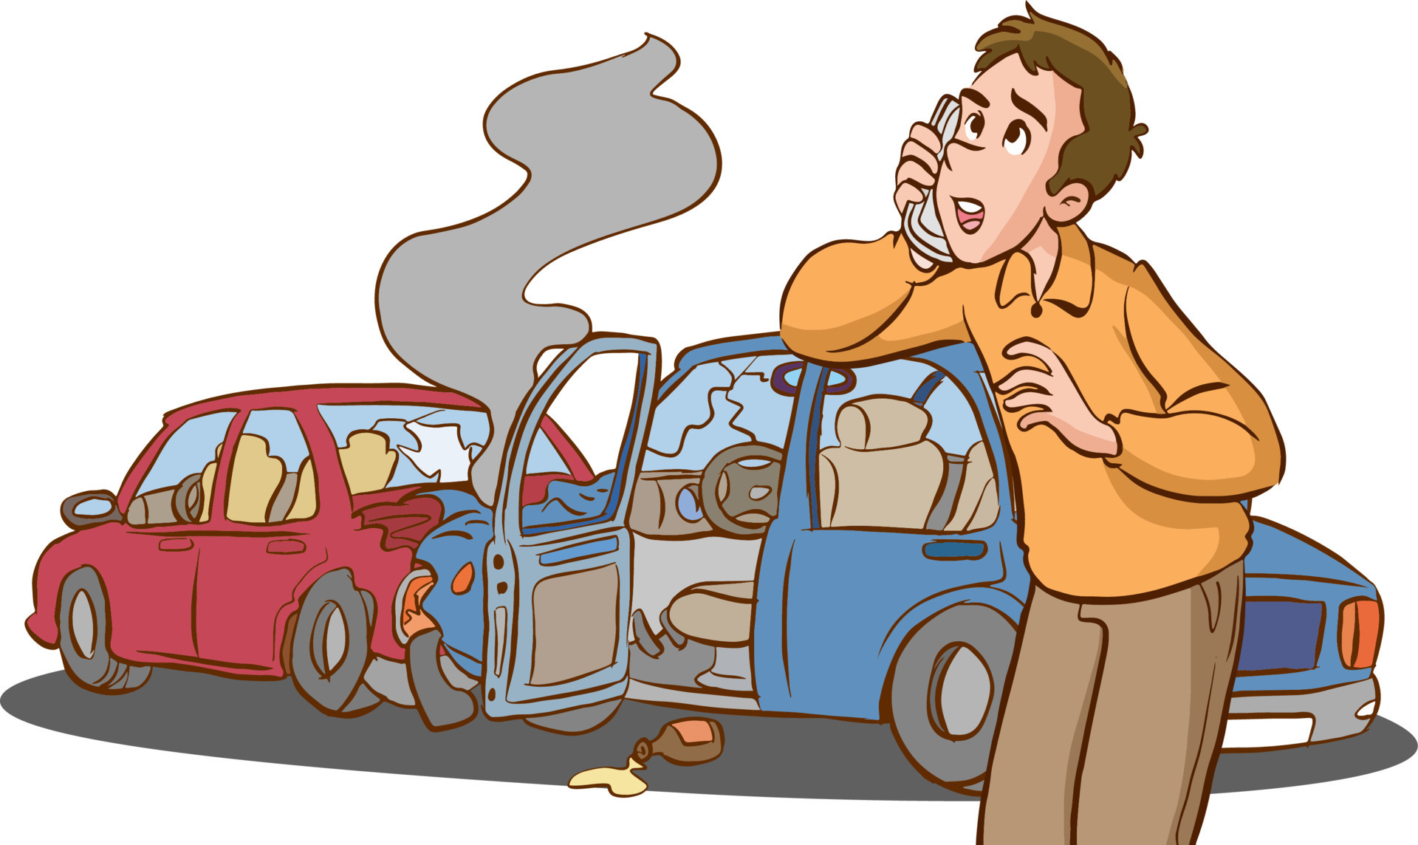
Aim and Objectives
Aim:
To design, develop, and deploy a web-based application for real-time road incident detection using CCTV feeds, Darknet YOLO and OpenCV in Python, with the ultimate goal of improving road safety and traffic management.
Objectives:
Build a web-friendly application that integrates CCTV camera feeds, processes video data in real time, and uses deep learning and OpenCV technology for crash detection.
Identify various road conditions, including accidents, closures, fire and weapon detection.
Provide live video, alerts and image detection. Automatic notifications send instant notifications to stakeholders, enabling rapid response and incident management.
Share information and knowledge to facilitate the advancement of smart transportation, ultimately increasing road safety, reducing congestion and improving traffic management.

Slide 6

Literature Survey
Sr No. | Authors | Paper Title | Year Of Study | Journal | Details Of Work | Methodology | Findings
1 | Feng Hong, Chang-Hua Lu, Chun Liu, Ru-Ru Liu & Ju Wei | A traffic surveillance multi-scale vehicle detection object method base on encoder-decoder | 2020 | IEEE | Work on traffic monitoring videos, for detection of vehicle tracking, traffic flow & follow-up licence plate recognition | The algorithm based on deep -learning are used. An encoding & decoding module is proposed. | YOLOv3 network model is introduced into the field of vehicle detection
2 | Haidi Zhu, Xin Yan, Hongying Tang, Yuchao Chang, Baoqing Li & Xiaobing Yuan | Moving Object detection with Deep CNNs(Convolutional Neural Network) | 2019 | IEEE | This paper proposes a novel framework that perform real-time detection and identification of moving object | Deep convolution neural network are leveraged to identify category of object. | They replace YOLOv3 to Mtiny YOLOv3 which is faster and accurate.

Slide 7
Literature Survey
Sr No. | Authors | Paper Title | Year Of Study | Journal | Details Of Work | Methodology | Findings
3 | Yujie Wu, Hong Zhang, Yifan Yang & Ding Yuan | Video object detection guided by object blur evaluation | 2020 | IEEE | They proposed end-to-end blur-aid feature aggregation network (BFAN) for video object detection. | The BFAN model is based on pixel level feature aggregation by image processing | The saliency detection network is adopted to focus and detect blur
4 | Mehul Mahrishi, Sudha Morwal, Abdul Wahab Muzaffar, Surbhi Bhatia, Pankaj Dadheech & Mohammad Khalidimam Rahmani | Video Index Point Detection and Extraction Framework Using Custom YoloV4 Darknet Object Detection Model | 2021 | IEEE | The literature claims that learners are nowadays less interested in viewing a complete video but prefers the topic of their interests. This develops the need for indexing of video lectures. | Shot Boundary detection is performed using Structural Similarity fused with a Binary Search Pattern algorithm which outperformed the state-of-the-art SSIM technique | The study establishes a basis for indexing digital video through the YOLO V4 Darknet Neural Network.

Slide 8
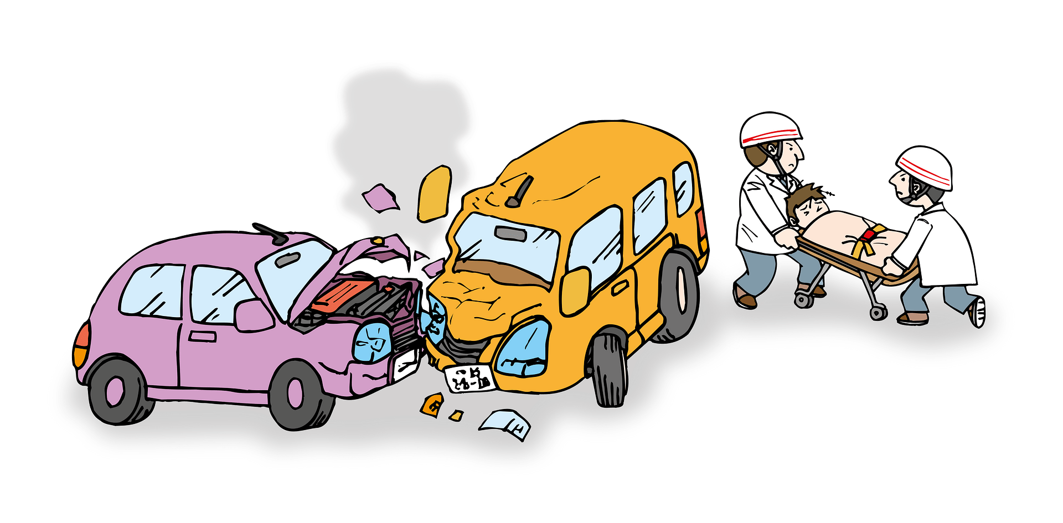
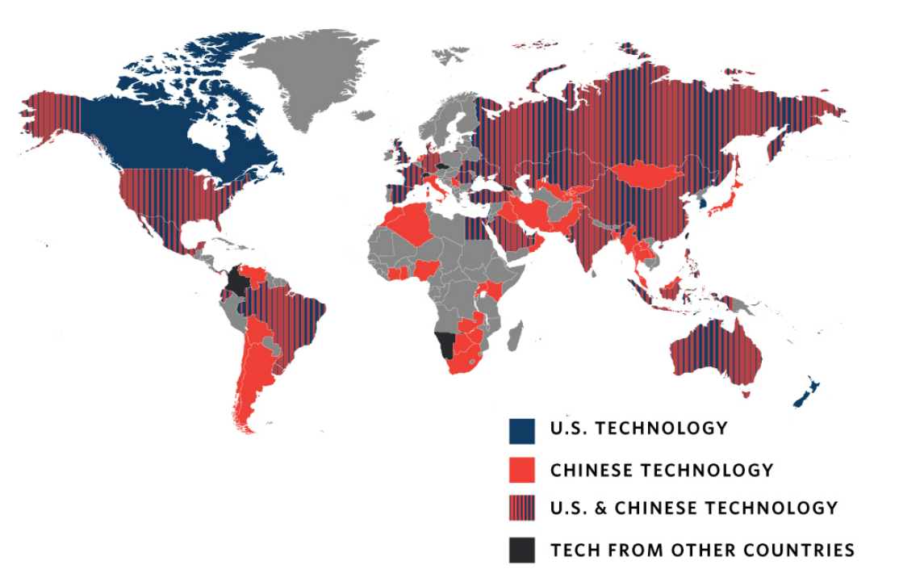
Existing System
At least seventy-five out of 176 countries globally are actively using AI technologies for road incident surveillance purposes.
The European Commission developed the eCall system and has decreed its mandatory deployment in every vehicle developed after 2015. The eCall system detects an accident and informs the emergency number 112 (999 in the UK and some other countries)
Major Drawback factor is the hardware costing and hardware failure.

Slide 9




Dubai:Dubai has launched an AI-powered smart traffic system to predict vehicle flow, prepare response plans, and make real-time collision decisions. The system aims to improve road safety and support mobility. The Dubai Roads and Transport Authority is also working on the second phase of the Smart Pedestrian Signals project, combining smart technologies and the Internet of Things to enhance pedestrian and driver safety.
New York City's LinkNYC: New York City's LinkNYC program involves the deployment of smart kiosks that provide free Wi-Fi and other services. Some of these kiosks are equipped with cameras and sensors to monitor traffic and pedestrian flow. This data can be used for incident detection and city planning.
Singapore's Traffic Management System: Singapore is known for its advanced traffic management system. The system uses a network of cameras and sensors to monitor traffic flow, detect incidents, and adjust traffic signals in real-time to optimize traffic flow.

Slide 10



Los Angeles Metro's Real-Time Operations Center: The Los Angeles Metro operates a Real-Time Operations Center (RTOC) that uses video feeds, GPS data, and other technologies to monitor the city's transit system. It helps detect incidents, manage routes, and improve overall transportation efficiency.
Waze Traffic App: While not a government-run system, the Waze traffic app collects real-time data from users' smartphones to provide information on traffic conditions, road closures, and incidents. It's an example of crowdsourced incident reporting.

Slide 11

Drawbacks of Existing Systems
Limited to Specific Use Cases: Each paper seems to be tailored to a specific application, such as traffic surveillance or video indexing. These models may not generalize well to other domains or require significant adaptation for broader use.
Dependency on Dataset Quality: The effectiveness of deep learning models heavily depends on the quality and diversity of the training dataset. Limited or biased training data can result in model limitations and biases.
Sensitivity to Environmental Conditions: Video object detection models can be sensitive to lighting, weather conditions, and camera perspectives. They may not perform well under adverse conditions.
Ethical and Privacy Concerns: In applications like traffic surveillance, there can be significant ethical and privacy concerns related to the collection and analysis of video data, especially if not handled appropriately.

Slide 12

Problem Statement:
The need for intelligent traffic accident awareness that can effectively and accurately identify and classify different types of incidents in real time using CCTV cameras. The system must solve problems such as classification of incidents, timely warning and accuracy to improve road safety, traffic management and emergency response.

Slide 13
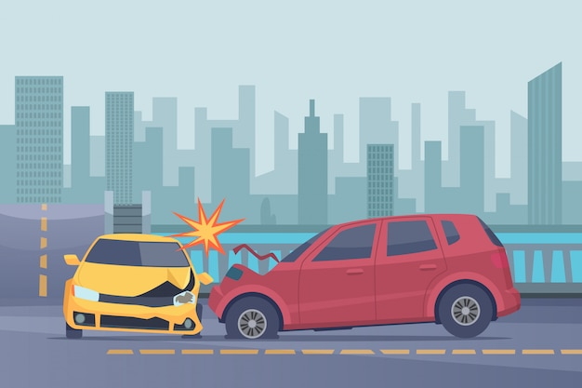
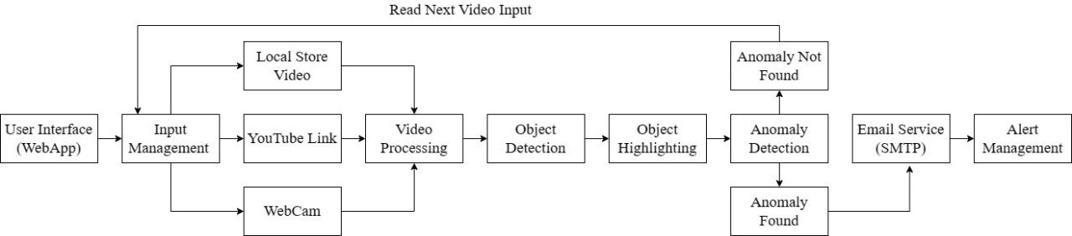
Proposed System

Slide 14

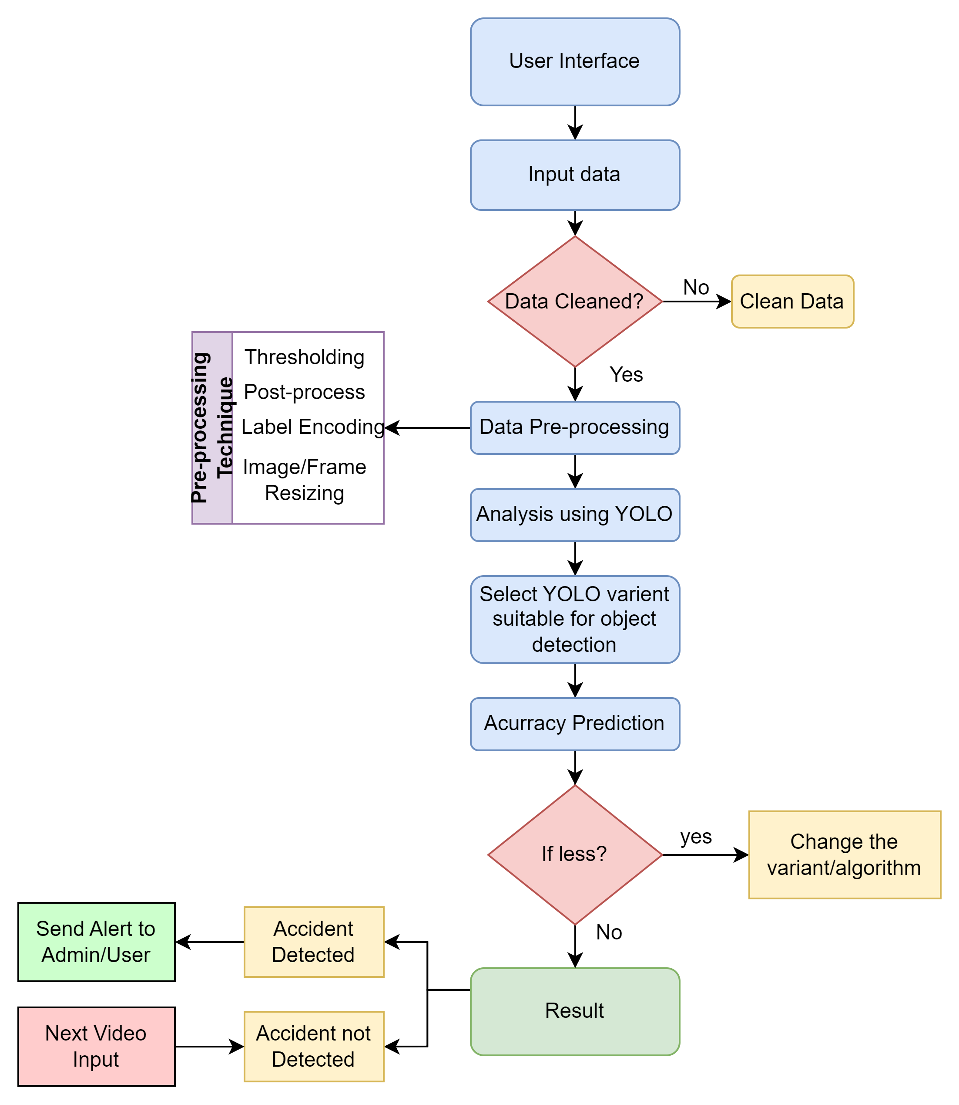
Methodology:

Slide 15
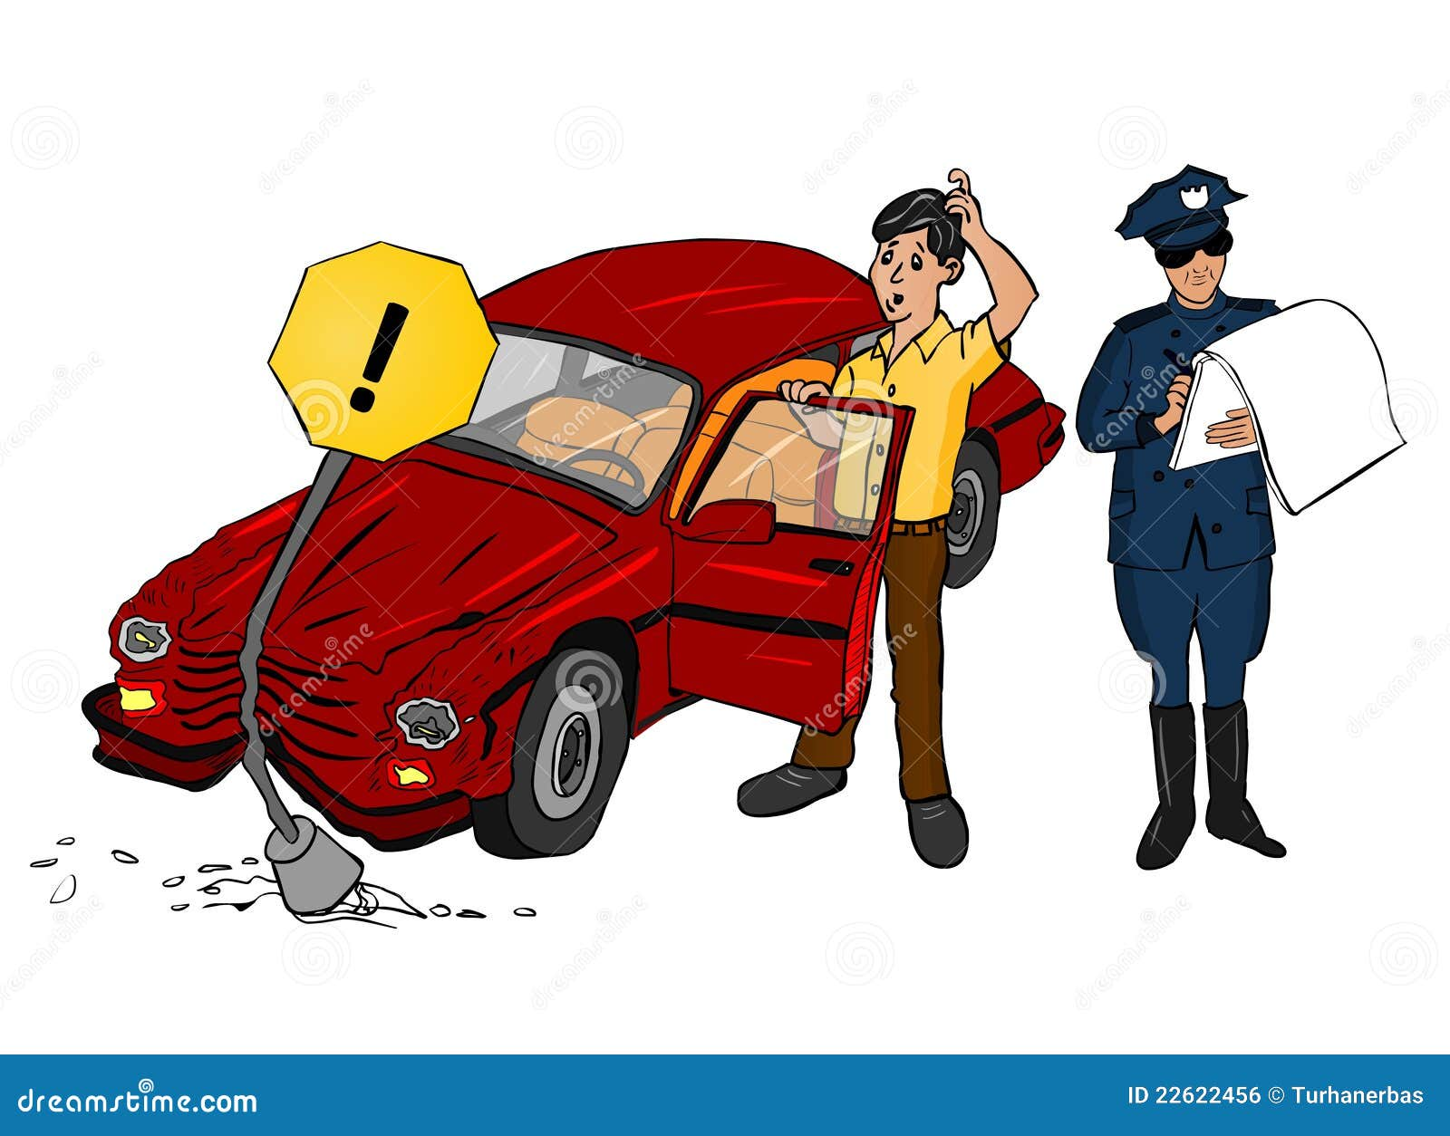
Algorithms:
YOLO Algorithm :
YOLO is an advanced object detection algorithm that aims to efficiently and accurately detect objects within images and video frames. It builds upon the YOLO (You Only Look Once) architecture, known for its real-time detection capabilities. YOLO is designed to strike a balance between speed and accuracy, making it suitable for various computer vision applications, including road anomaly detection.
NMS Algorithm:
Non-Maximum Suppression (NMS) is a technique used in object detection algorithms to eliminate redundant or overlapping bounding boxes and retain only the most relevant and accurate ones. It ensures that for a given object in the scene, only one bounding box is kept, typically the one with the highest confidence score.

Slide 16

YOLO Algorithm Pseudo-Code
# Input: An image for object detection
# Step 1: Preprocess the input image: preprocess_image()
# Step 2: Extract features using deep CNN layers: features = extract_features(input_image)
# Step 3: Apply a Feature Pyramid Network (FPN) for multi-scale features:
multi_scale_features = apply_FPN(features)
# Step 4: Predict object bounding boxes, class probabilities, and objectness scores:
predictions = predict(multi_scale_features)
# Step 5: Apply anchor boxes to predictions: predicted_boxes = apply_anchor_boxes(predictions)
# Step 6: Non-Maximum Suppression (NMS) to filter redundant boxes: filtered_boxes = apply_NMS(predicted_boxes)
# Step 7: Output the detected objects: output_objects = format_output(filtered_boxes)
# Step 8: Post-processing for visualization and analysis: visualize_output(output_objects)
# Output: List of detected objects with coordinates, labels, and confidence scores

Slide 17

NMS Algorithm Pseudo Code:
# Input: List of bounding boxes with associated confidence scores
# Output: List of selected bounding boxes after NMS
# Step 1: Sort the bounding boxes by their confidence scores in descending order
sorted_boxes = sort_boxes_by_confidence(bounding_boxes)
# Step 2: Initialize an empty list to store the selected bounding boxes
selected_boxes = []
# Step 3: Loop through the sorted bounding boxes
for box in sorted_boxes:
# Add the current box to the selected list
selected_boxes.append(box)
# Compare the current box with all remaining boxes
for other_box in sorted_boxes:
if box and other_box overlap significantly:
# Remove the other_box from consideration
remove other_box from sorted_boxes
# Step 4: Return the selected_boxes as the final list of non-overlapping bounding boxes
return selected_boxes

Slide 18
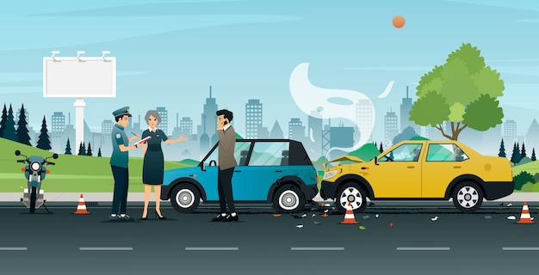
Hardware Requirements
CPU:
Intel Core i5-7400:
Cores: 4
Threads: 4
Base Clock: 3.0 GHz
Max Turbo Boost: 3.5 GHz
GPU:
NVIDIA GeForce GTX 1050 Ti:
GPU Architecture: Pascal
CUDA Cores: 768
VRAM: 4 GB GDDR5
Base Clock: 1290 MHz
Boost Clock: 1392 MHz
Memory Bus: 128-bit
TDP: 75W
RAM: You should have at least 8GB of RAM, but more RAM is better, especially if
you are dealing with large datasets or high-resolution images.
Storage: Minimum 100 GB

Slide 19
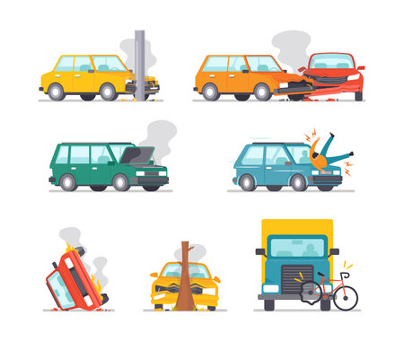
Software requirements :
1. Real-time Data Processing: OpenCV
2. Deep Learning Framework: Ultralytics YOLO
3. Data Analytics Tools:
Data analytics and visualization tools (e.g., Python libraries like pytube, Streamlit, Geocoder,webbrowser,etc) for generating reports and insights.
4. Prerequisites for running darknet and opencv
Python: Language in which code is written
Visual Studio Code: For building openCV and darknet code
Nvidia GPU Driver: For faster GPU performance
CuDNN: A GPU-accelerated library of primitives for deep neural networks

Slide 20
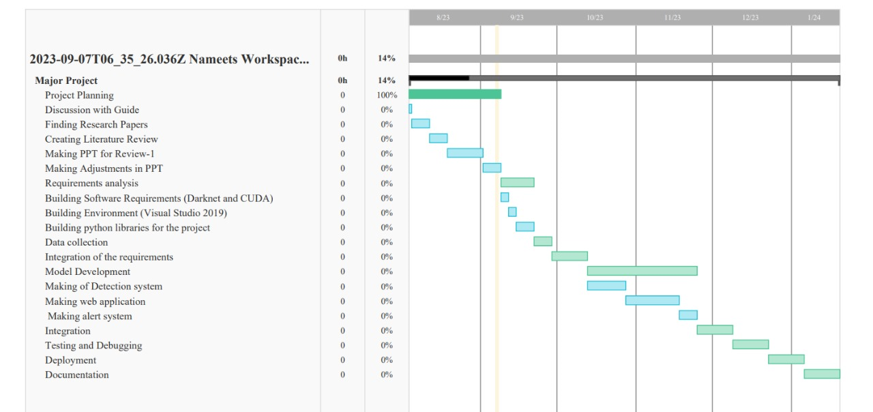
Implementation plan:

Slide 21
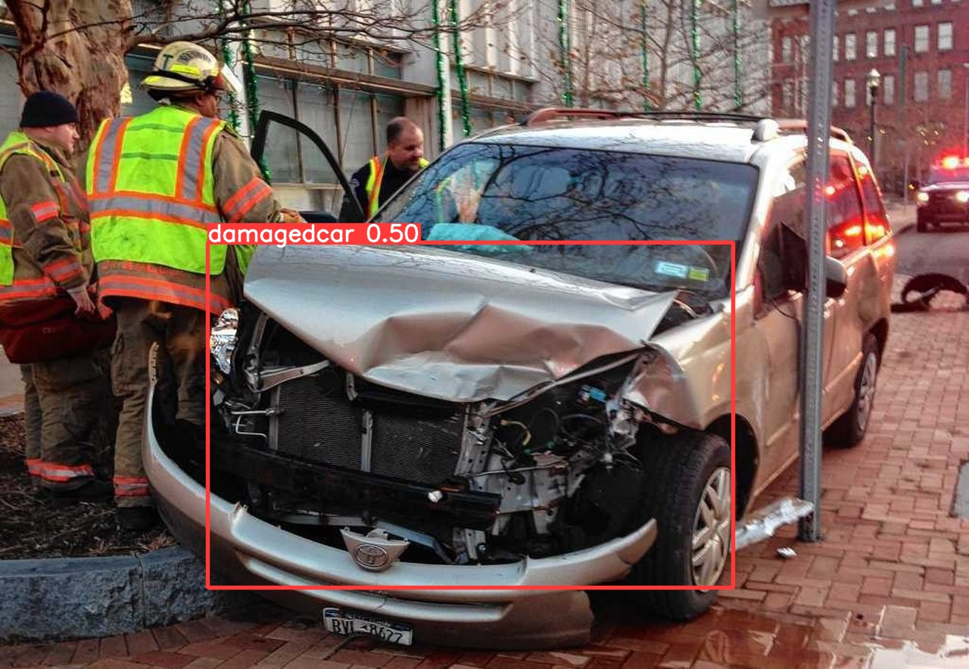
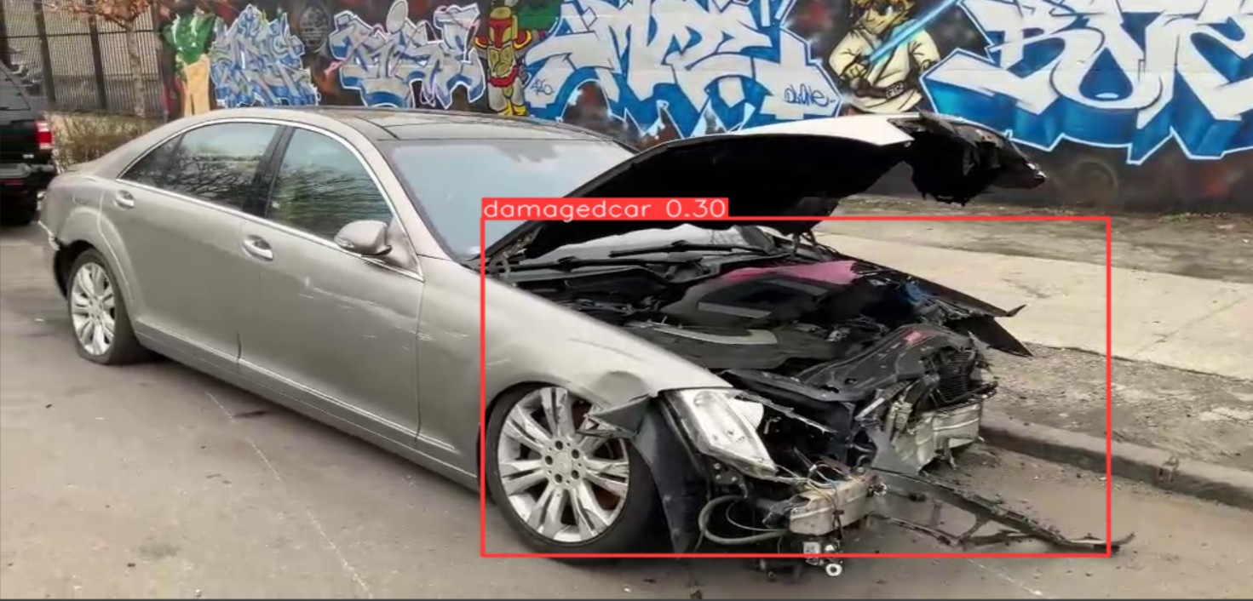

Slide 22
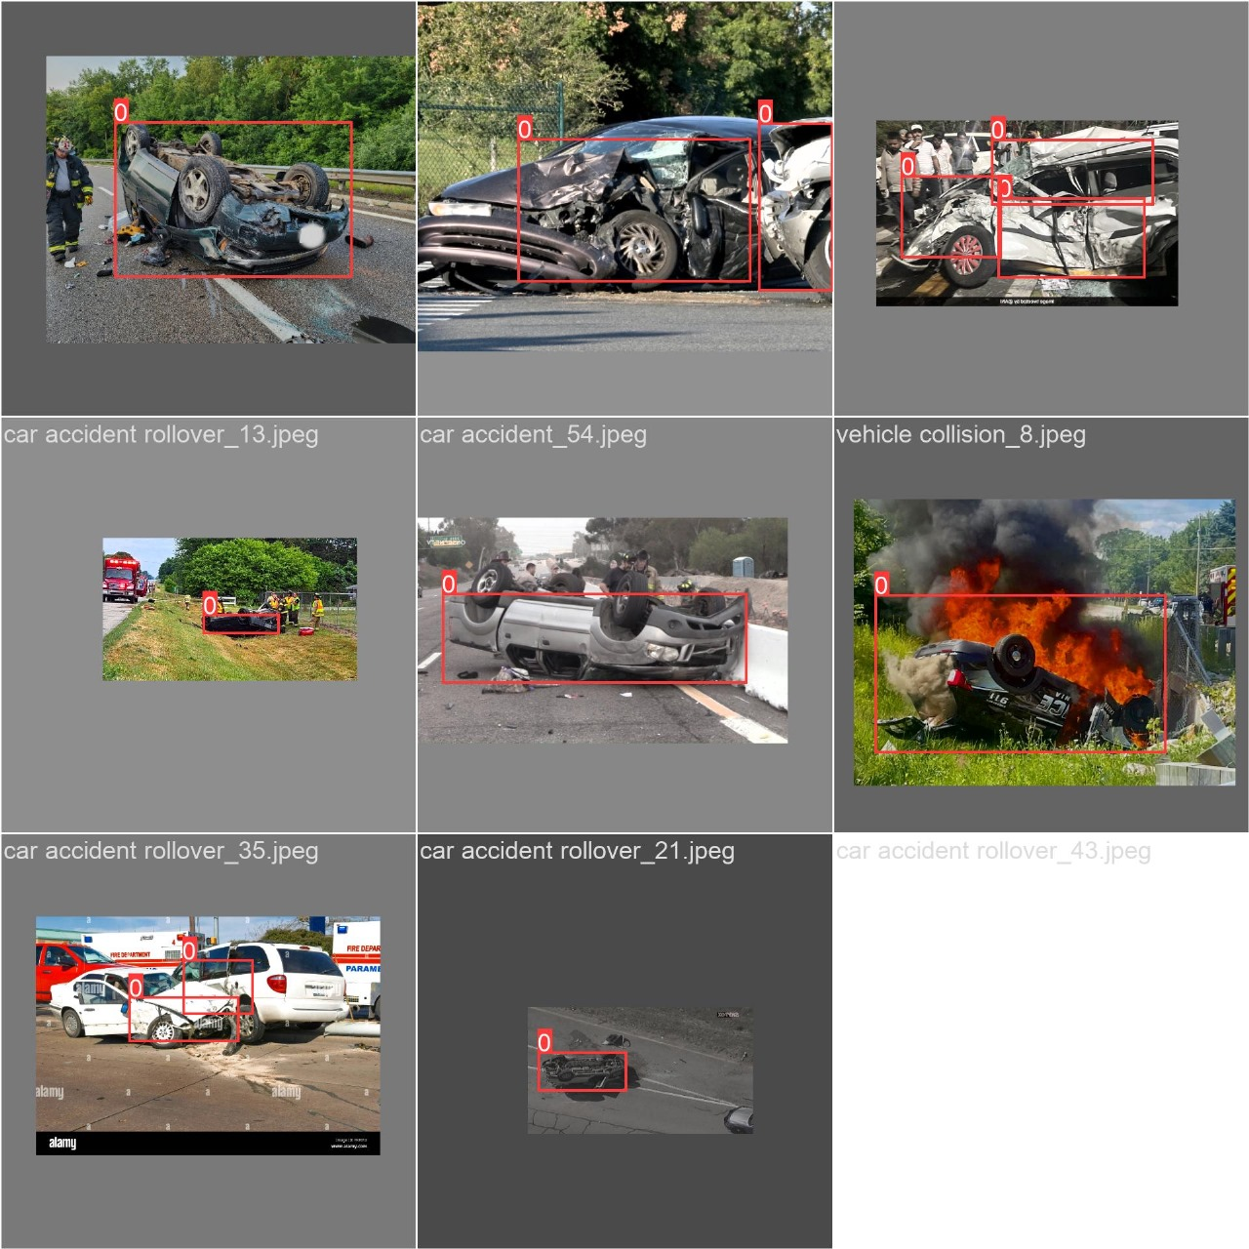
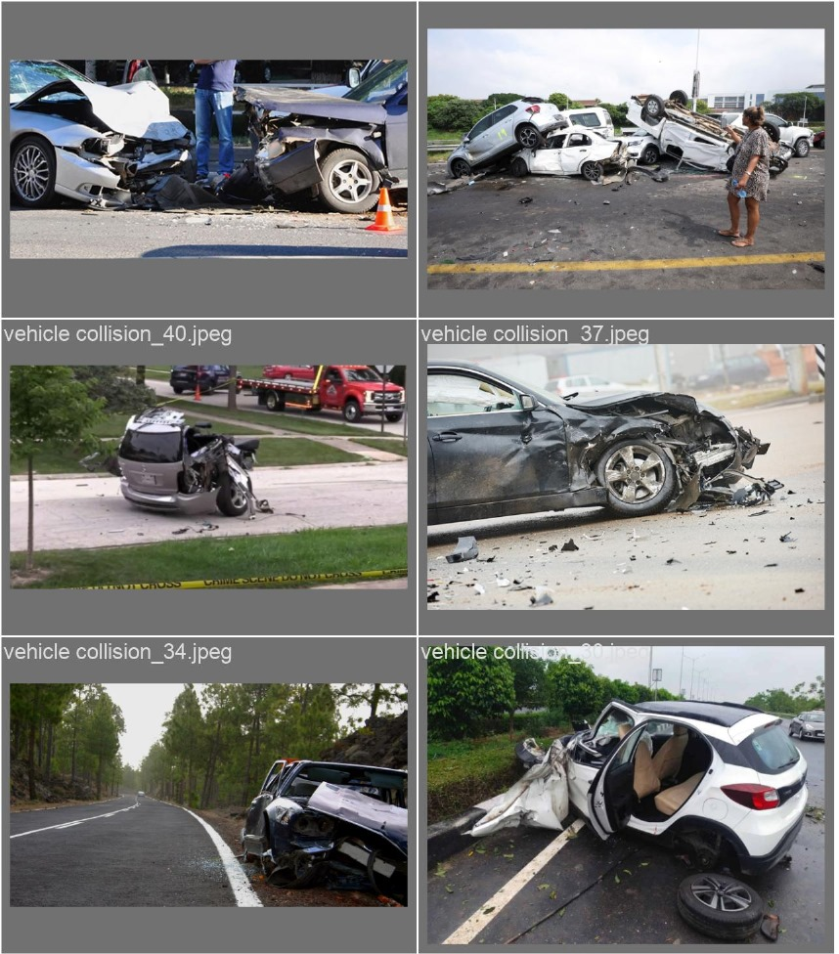

Slide 23
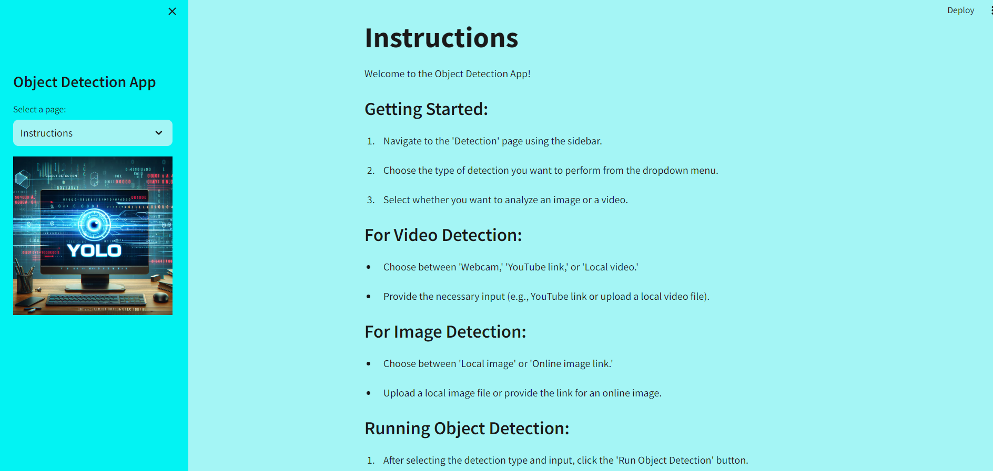

Slide 24
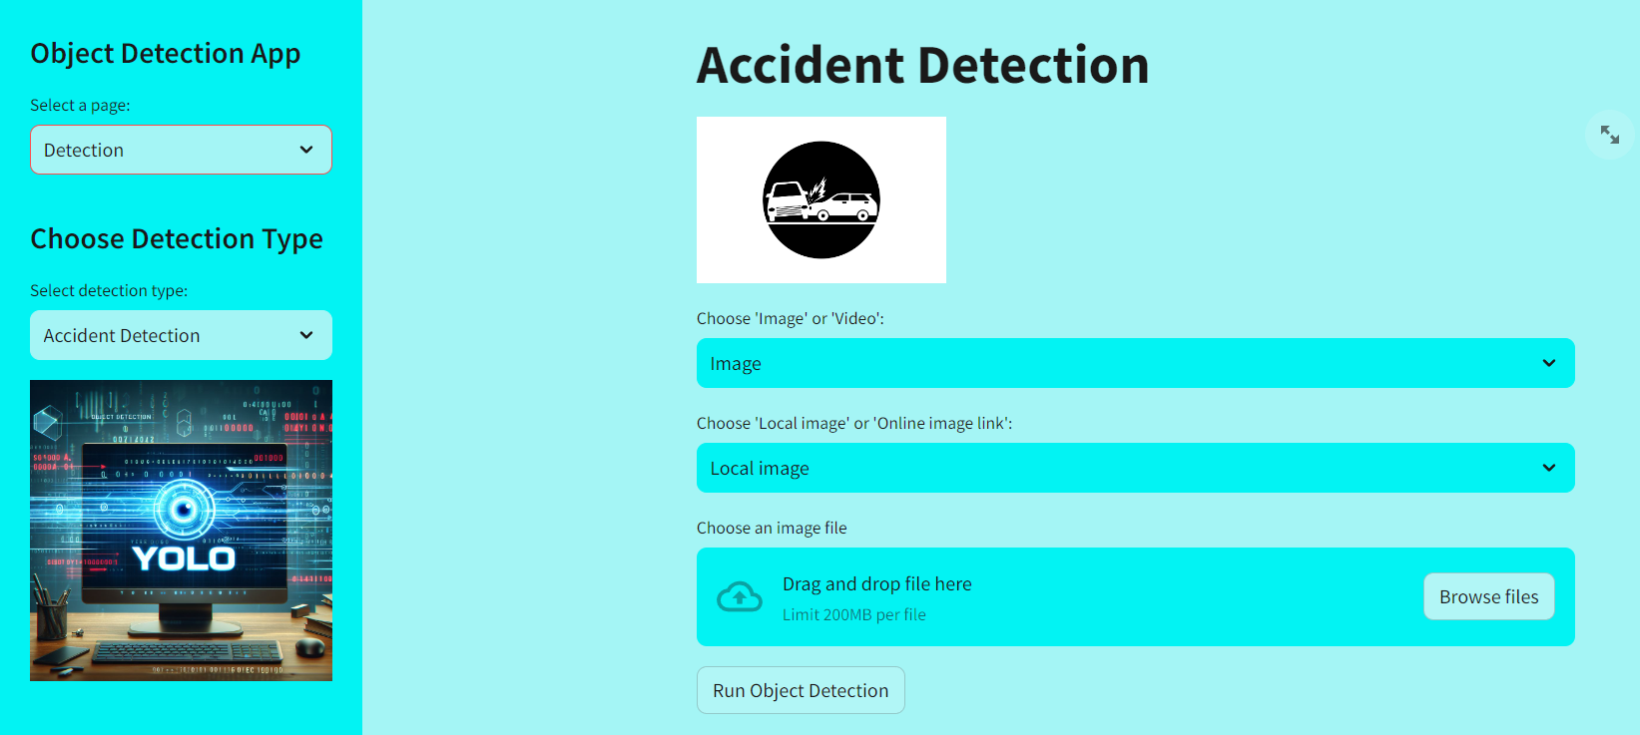

Slide 25
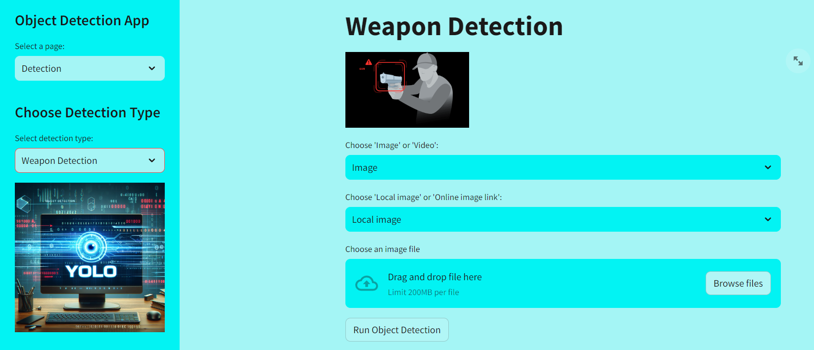

Slide 26
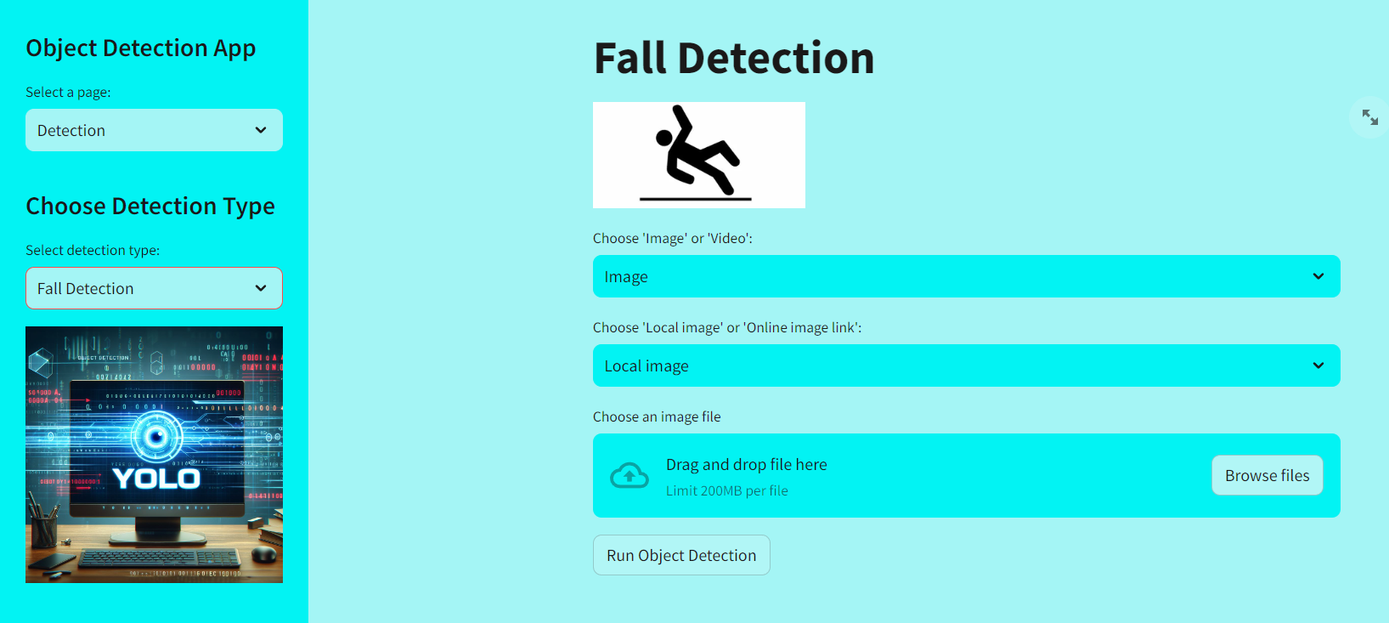

Slide 27
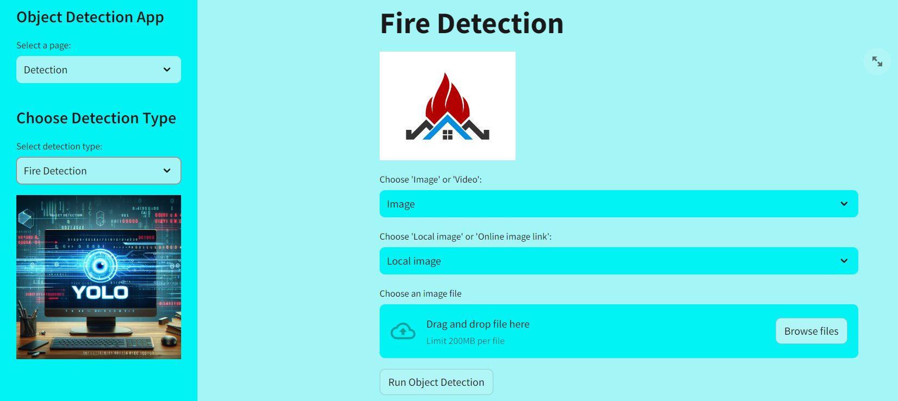

Slide 28
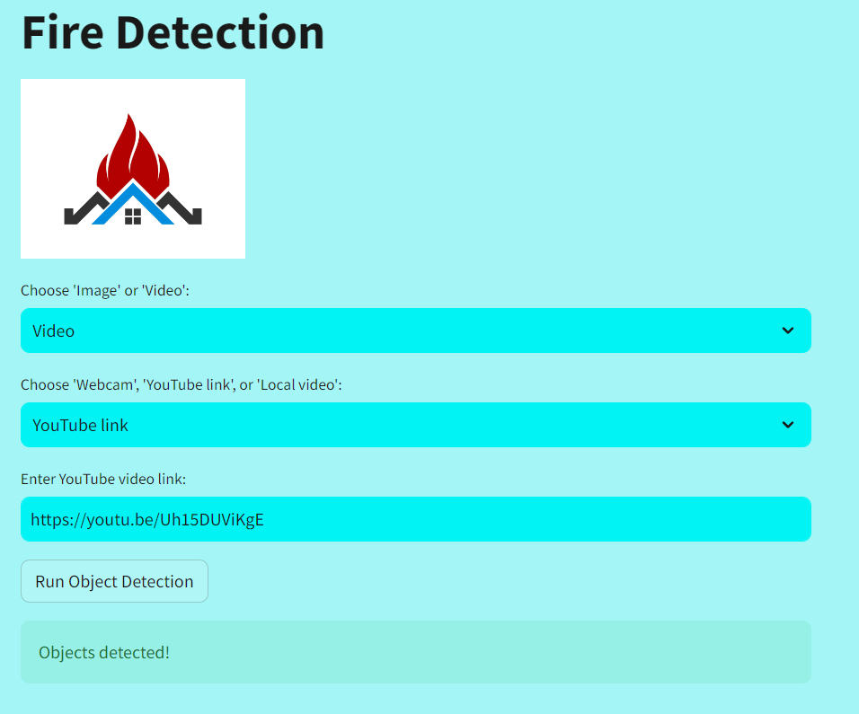
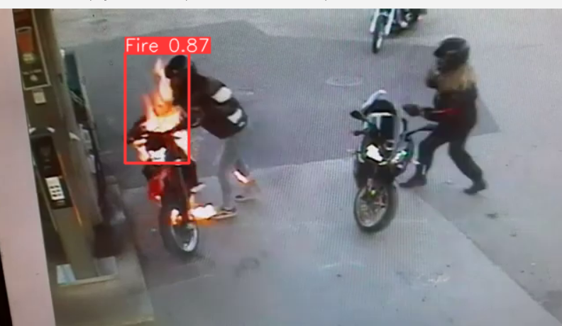

Slide 29
Conclusion
Accident is a problem that causes loss of life and property. A road incident detection system can track incidents and send instant reports to nearby hospitals and police stations. The system which we are bulding aims to be cost-effective, precise, and increased accuracy for incident detection on Roads. The mentioned things will allow our system to be use for state and national highways surveillance. The project aims to improve the quality of life by ensuring that no one is left without help or assistance in emergencies.

Slide 30

References
[1] F. Hong, C. -H. Lu, C. Liu, R. -R. Liu and J. Wei, "A Traffic Surveillance Multi-Scale Vehicle Detection Object Method Base on Encoder-Decoder," in IEEE Access, vol. 8, pp. 47664-47674, 2020, doi: 10.1109/ACCESS.2020.2979260.
[2] H. Zhu, X. Yan, H. Tang, Y. Chang, B. Li and X. Yuan, "Moving Object Detection With Deep CNNs," in IEEE Access, vol. 8, pp. 29729-29741, 2020, doi: 10.1109/ACCESS.2020.2972562
[3] Y. Wu, H. Zhang, Y. Li, Y. Yang and D. Yuan, "Video Object Detection Guided by Object Blur Evaluation," in IEEE Access, vol. 8, pp. 208554-208565, 2020, doi: 10.1109/ACCESS.2020.3038913.
[4] M. Mahrishi, S. Morwal, A. W. Muzaffar, S. Bhatia, P. Dadheech and M. K. I. Rahmani, "Video Index Point Detection and Extraction Framework Using Custom YoloV4 Darknet Object Detection Model," in IEEE Access, vol. 9, pp. 143378-143391, 2021, doi: 10.1109/ACCESS.2021.3118048.
[5] D. Singh and C. K. Mohan, "Deep Spatio-Temporal Representation for Detection of Road Accidents Using Stacked Autoencoder," in IEEE Transactions on Intelligent Transportation Systems, vol. 20, no. 3, pp. 879-887, March 2019, doi: 10.1109/TITS.2018.2835308.
[6] D. A. Machhi, A. S. Pillai, S. S. More and P. Thirumalaikumar, "Accident Detection and Reporting using Convolution Neural Network," 2022 International Conference on Applied Artificial Intelligence and Computing (ICAAIC), Salem, India, 2022, pp. 207-212, doi: 10.1109/ICAAIC53929.2022.9793063.

Slide 31
Thank you

